Slide 1
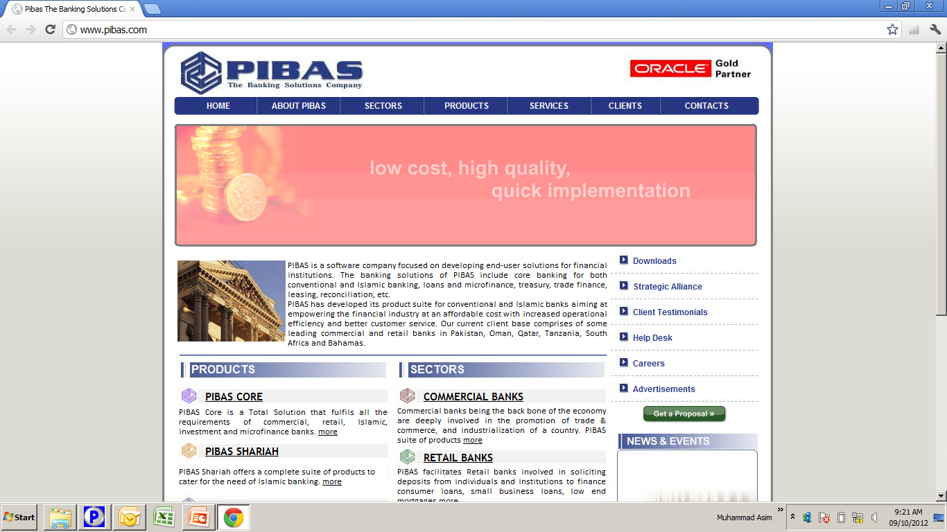
Fixed Term Deposits.
Fixed Term Deposits.

Slide 2
Contents
Fixed Term Deposits.
Fixed Term Deal Addition
Fixed Term Deal Maintenance
Fixed Term Deal Supervision
Fixed Term Deal Inquiry
Customer Summary
New Deals Report
Maintenance Report
Due For Maturity
Maturity Analysis
Customer Summary Report
Fixed Term Deals Type Parameter
Fixed Term Deals Interest Rate
Advance Tax Parameter

Slide 3
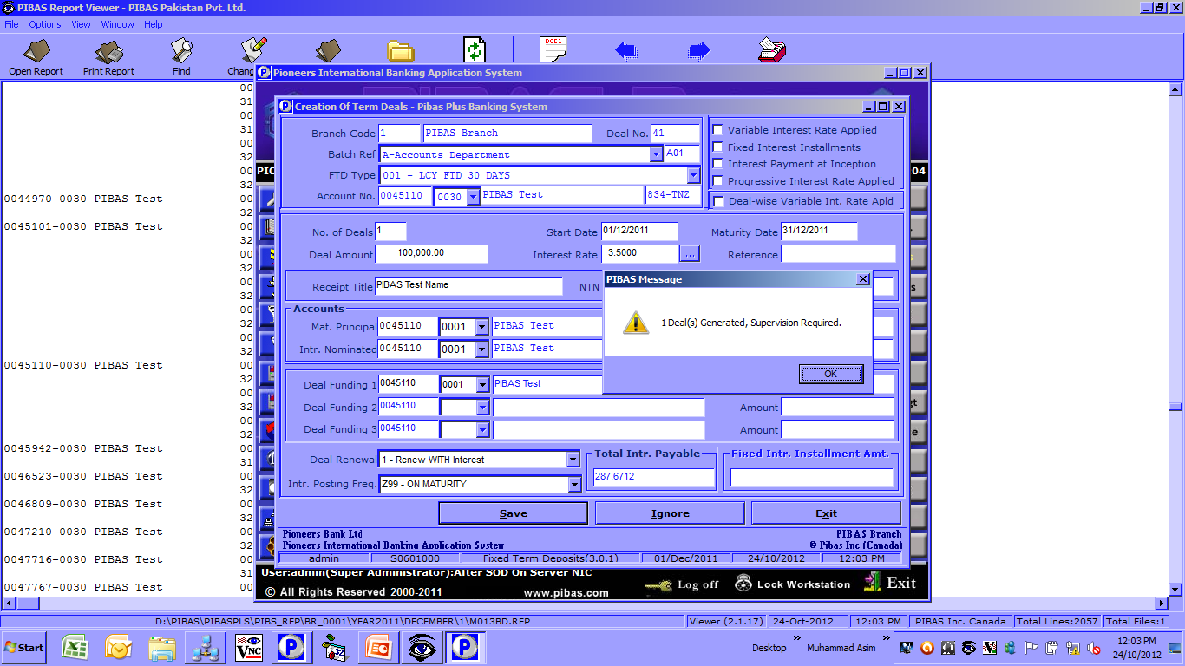
Fixed Term Deal Addition
Fixed Term Deposits.
How To Process / Important Points To Be Noted Before This Option
Only allowed customer types could be used for this option
Maturity Principal account will receive principal amount upon deal maturity
Interest Nominated account will received interest as per profit frequency set.
Deal Funding Account is used for issuance of Fixed Term Deposit, must have sufficient balance.

Slide 4
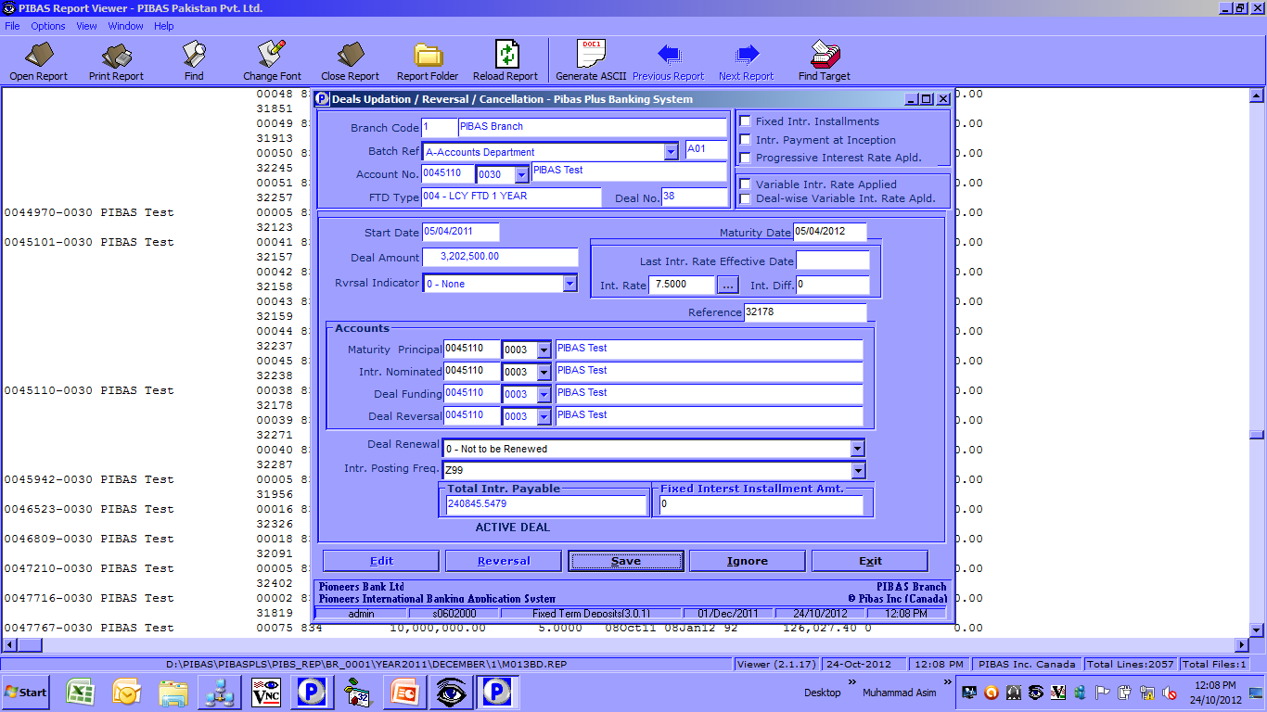
Fixed Term Deal Maintenance
Fixed Term Deposits.
How To Process / Important Points To Be Noted Before This Option
Only supervised / active deals could be amended
This option is also used for reversal of deal transactions
Amount cannot be amended

Slide 5
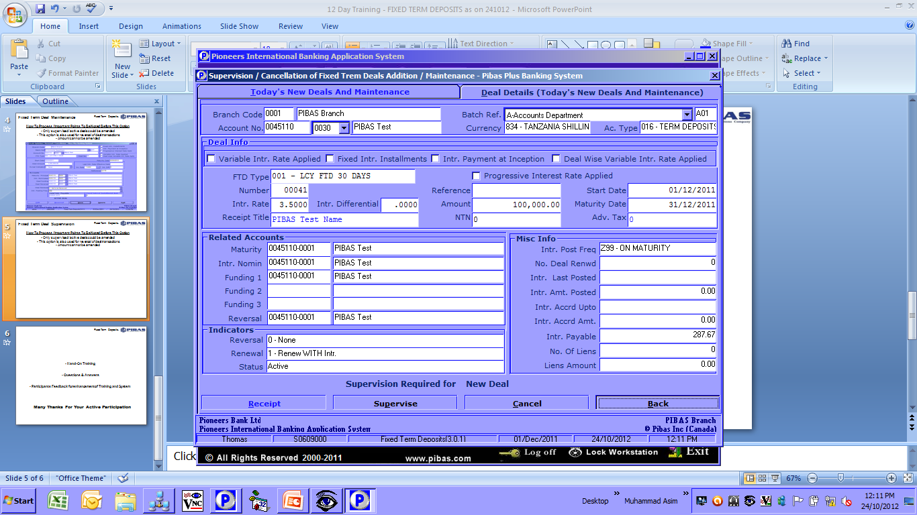
Fixed Term Deal Supervision
Fixed Term Deposits.
How To Process / Important Points To Be Noted Before This Option
This option is used to supervise / cancel any new deals or any amended deals and same user can’t

Slide 6
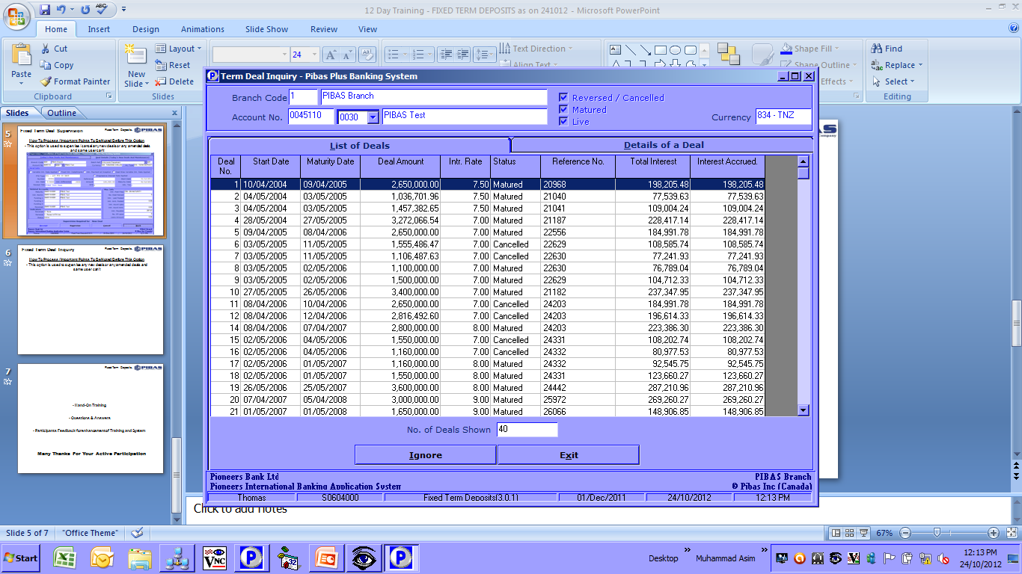
Fixed Term Deal Inquiry
Fixed Term Deposits.
How To Process / Important Points To Be Noted Before This Option
This option to view all deals (live, matured, cancelled etc.) of an account

Slide 7
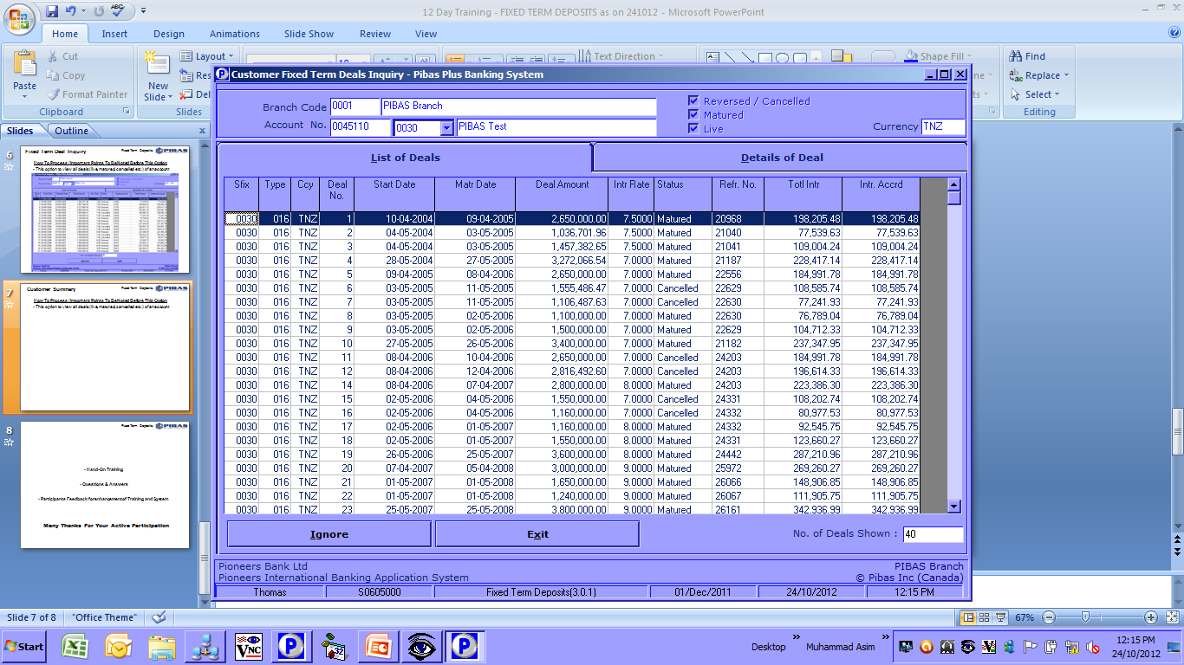
Customer Summary
Fixed Term Deposits.
How To Process / Important Points To Be Noted Before This Option
This option to view all deals (live, matured, cancelled etc.) of an account

Slide 8
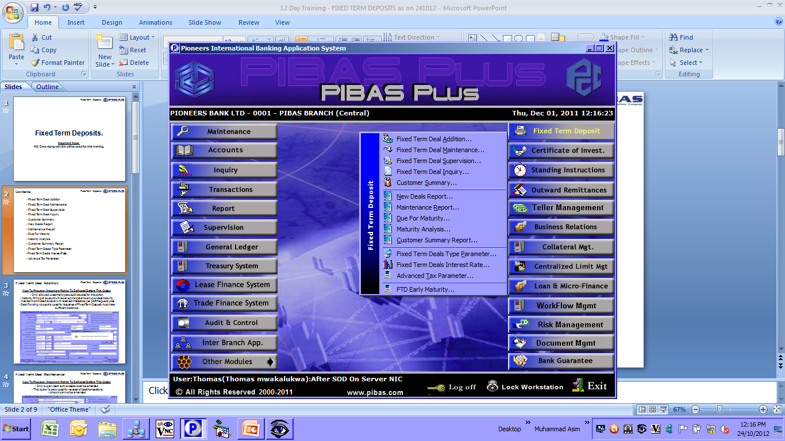
Related Reports
Fixed Term Deposits.
How To Process / Important Points To Be Noted Before This Option
These reports are very important and provide comprehensive information regarding Fixed Term Deposits

Slide 9
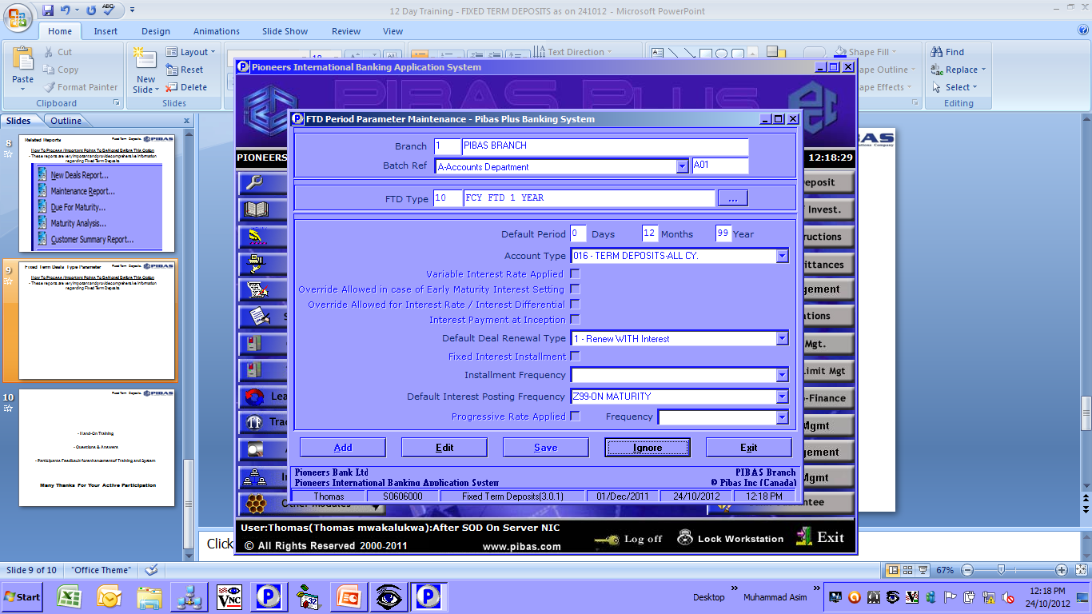
Fixed Term Deals Type Parameter
Fixed Term Deposits.
How To Process / Important Points To Be Noted Before This Option
This option is used to define Fixed Term Deposit Parameters

Slide 10
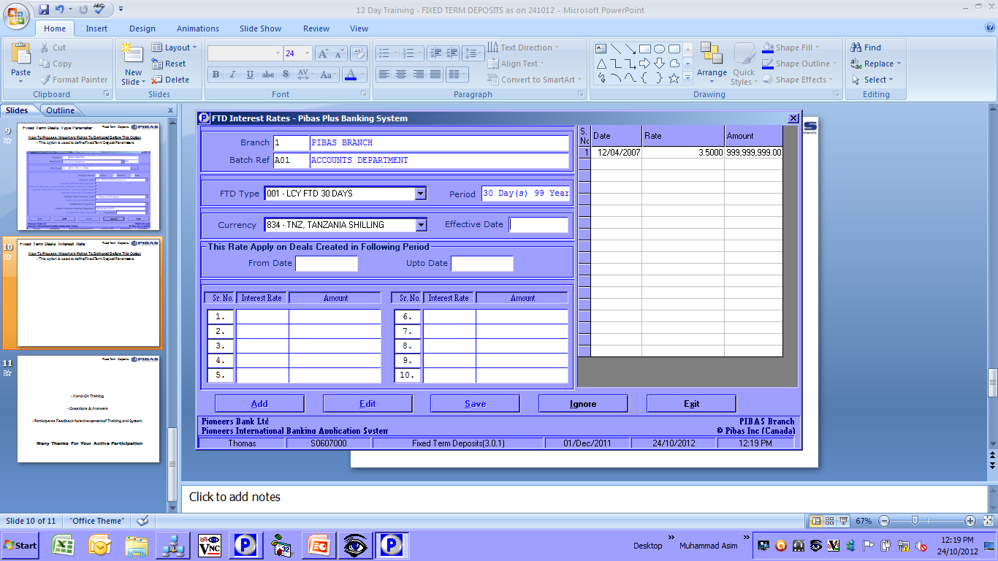
Fixed Term Deals Interest Rate
Fixed Term Deposits.
How To Process / Important Points To Be Noted Before This Option
This option is used to define Fixed Term Deposit Parameters for Interest Rates

Slide 11
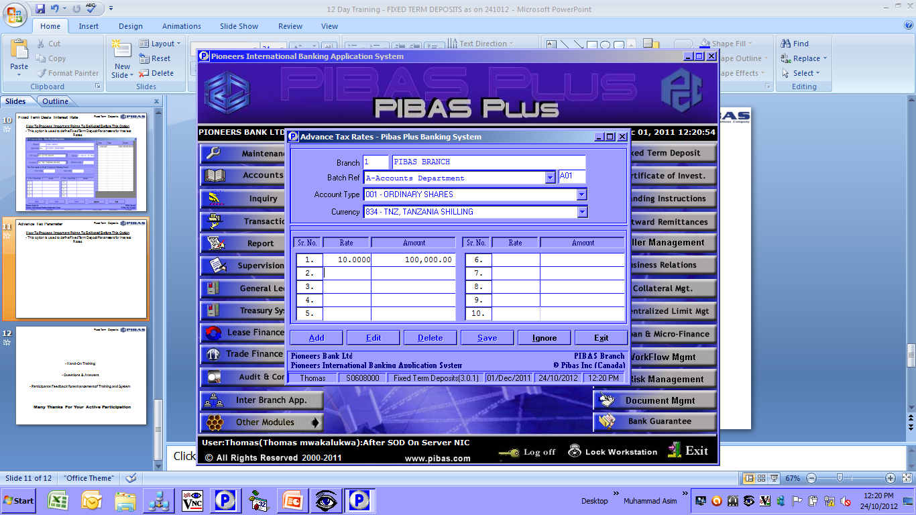
Advance Tax Parameter
Fixed Term Deposits.
How To Process / Important Points To Be Noted Before This Option
This option is used to define Fixed Term Deposit Parameters for Advance Tax Parameters, this may vary country to country

Slide 12
Fixed Term Deposits.
Hand-On Training
Questions & Answers
Participants Feedback for enhancement of Training and System
Many Thanks For Your Active Participation

